Slide 1


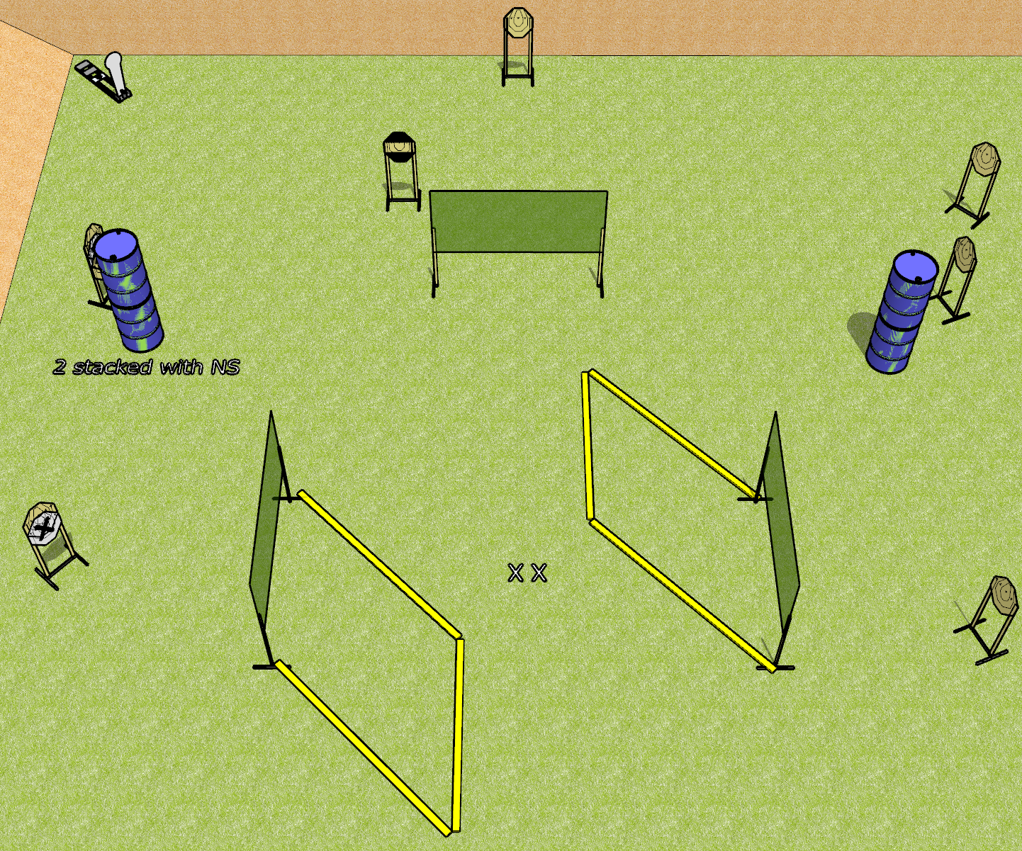
 | Dothan Gun Club – USPSA Match A Stage Has No Name Course Designer : Drew Coleman
Round Count 17 rounds 8 IPSC targets 1 colt popper
Equipment List 6 wall feet 1 stripe HC NOTE: use 2 10’ fault lines to extend away from the walls, and an 8’ to connect

Slide 2
A Stage Has No Name
Written Stage Briefing
A Stage Has No Name is a 17 round, 85 point, Comstock course of fire. There are 8 IPSC targets and 1 colt popper. The best 2 hits on paper will score, and steel must fall to score. The start signal is audible.
Handgun start position is both feet on X’s, wrists below belt. Handgun is loaded and holstered.
PCC start position is both feet on X’s. Loaded carbine is held with both hands, stock on belt, safety on.
On start signal, engage targets as they become available from within the shooting area.

